Slide 1
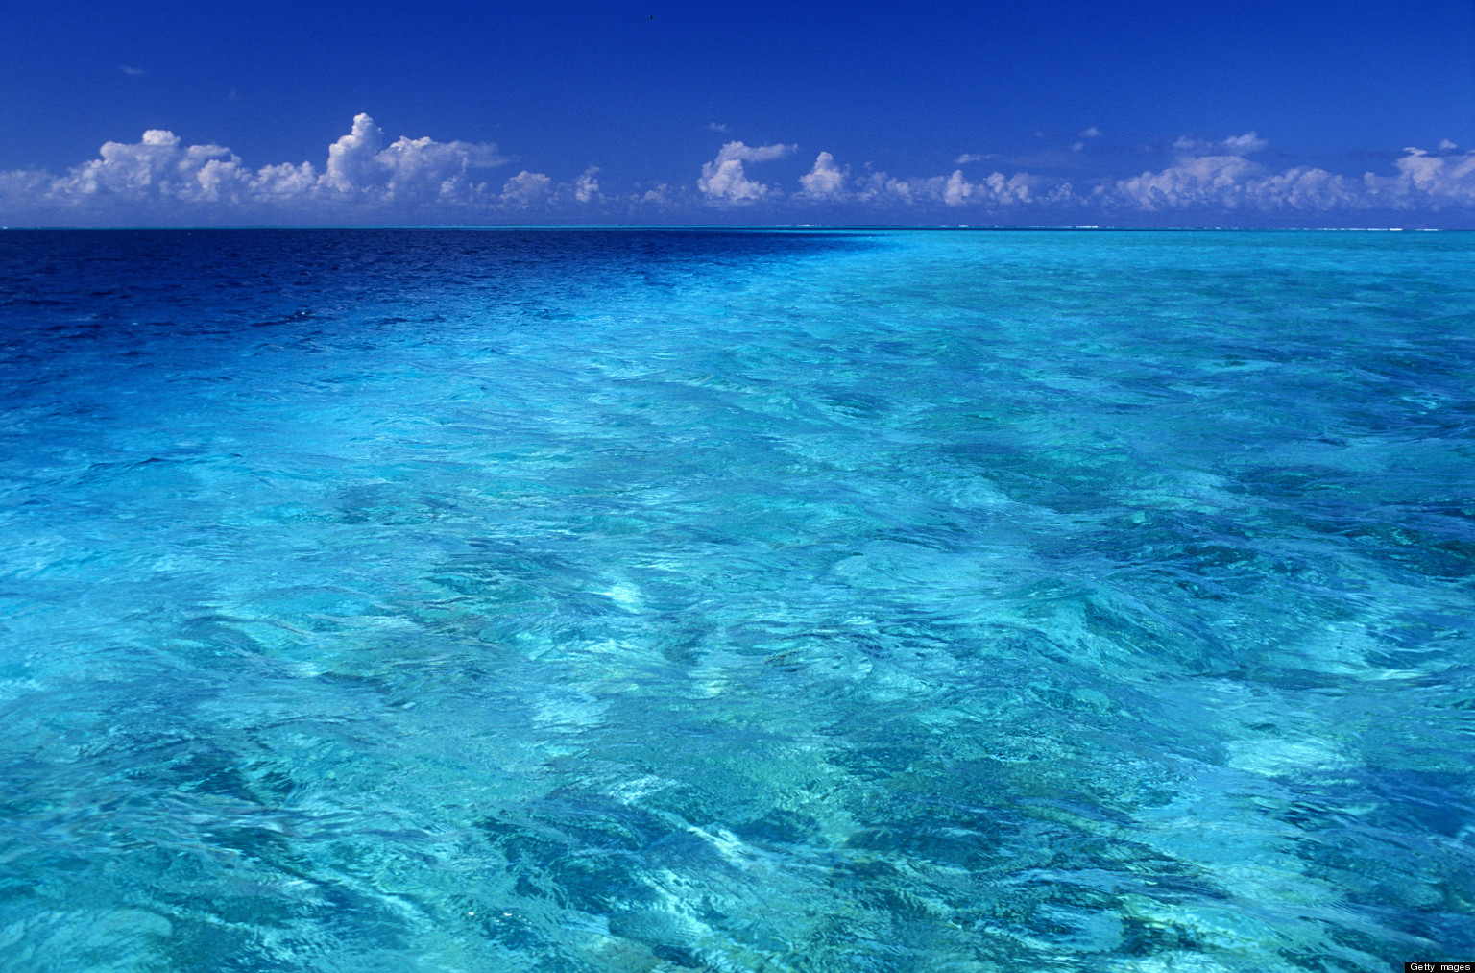

Objectif Goal
Oceans
M Jarraud
Secretary-General Emeritus
WMO
Geneva (9 June 2016)

Slide 2
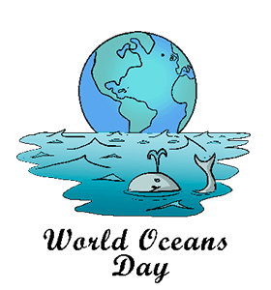
Oceans and Climate
Oceans cover over 70% of planet
largest component of climate system
Complex interactions between oceans, atmosphere, land and … human activities
Long time sacles associated with oceans
Significant progress in our knowledge of oceans, but…
Important remaining questions!

Slide 3
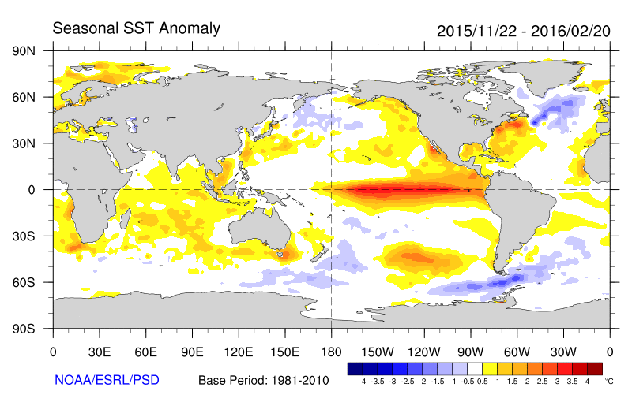
El Niño
El Niño and Southern Oscillation: ENSO
El Niño: Ocean component of ENSO
Southern Oscillation: atmospheric component of ENSO

Slide 4
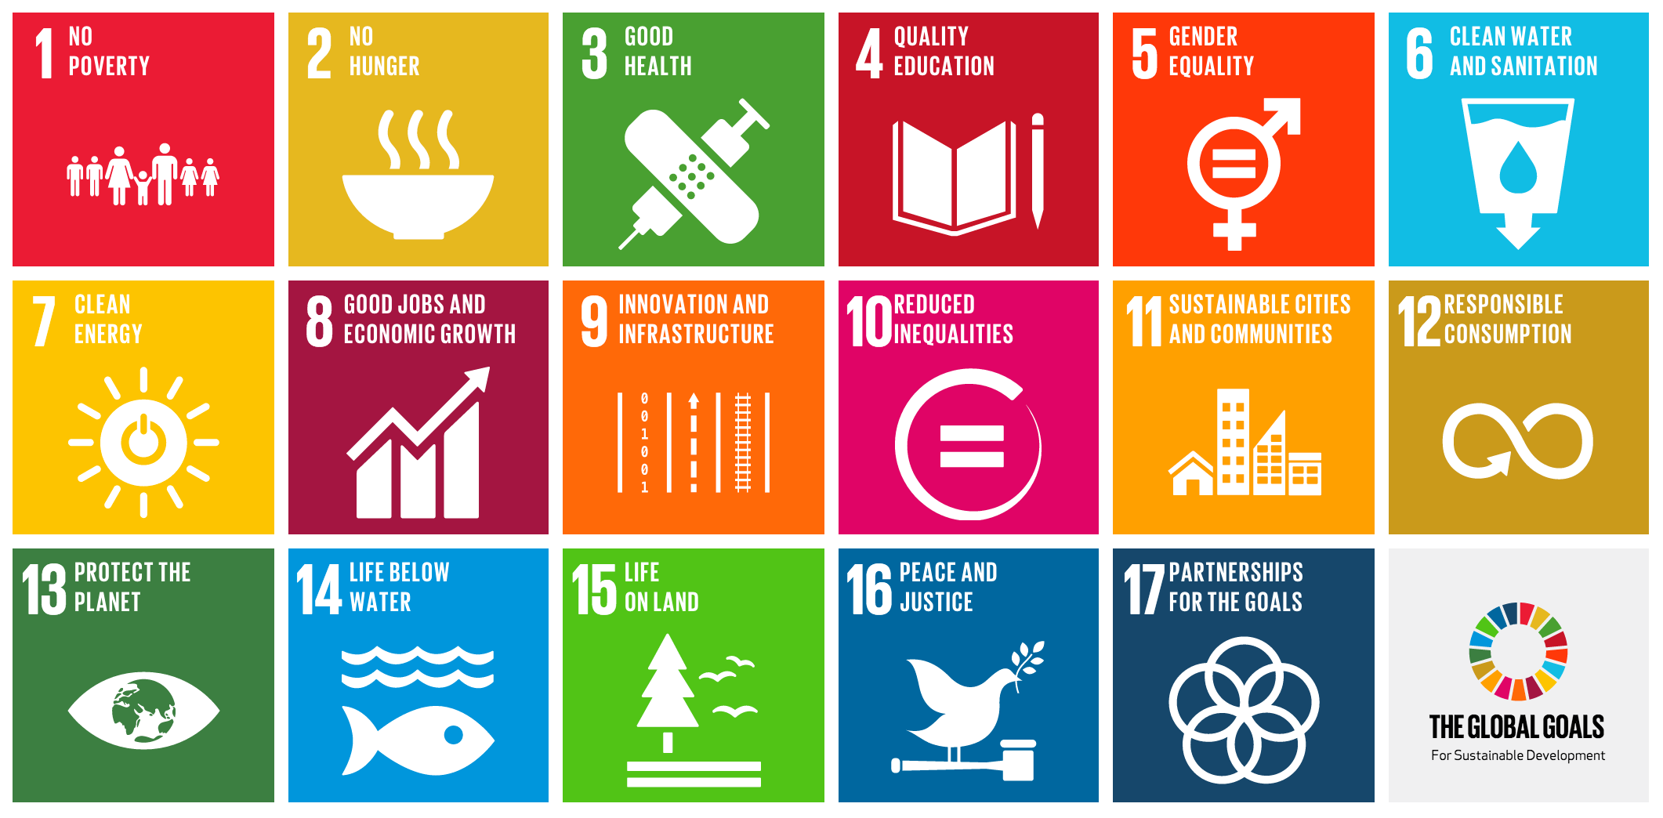
Oceans and sustainable development

Slide 5
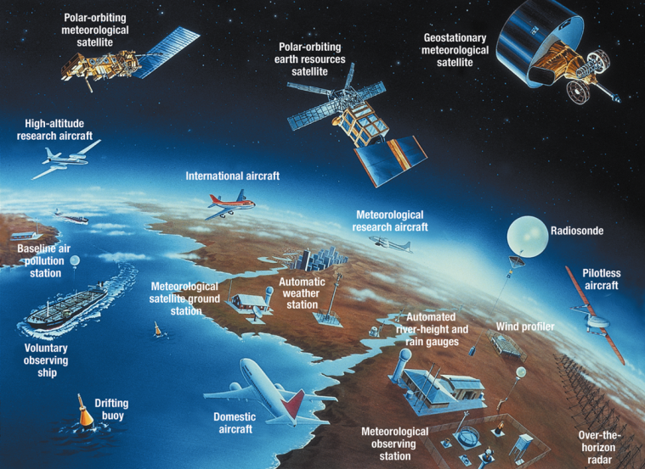
Oceans observations (1)

Slide 6
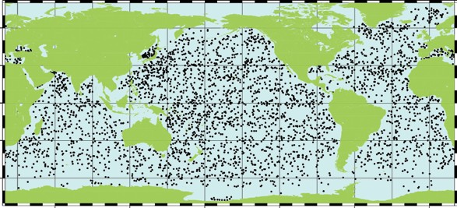

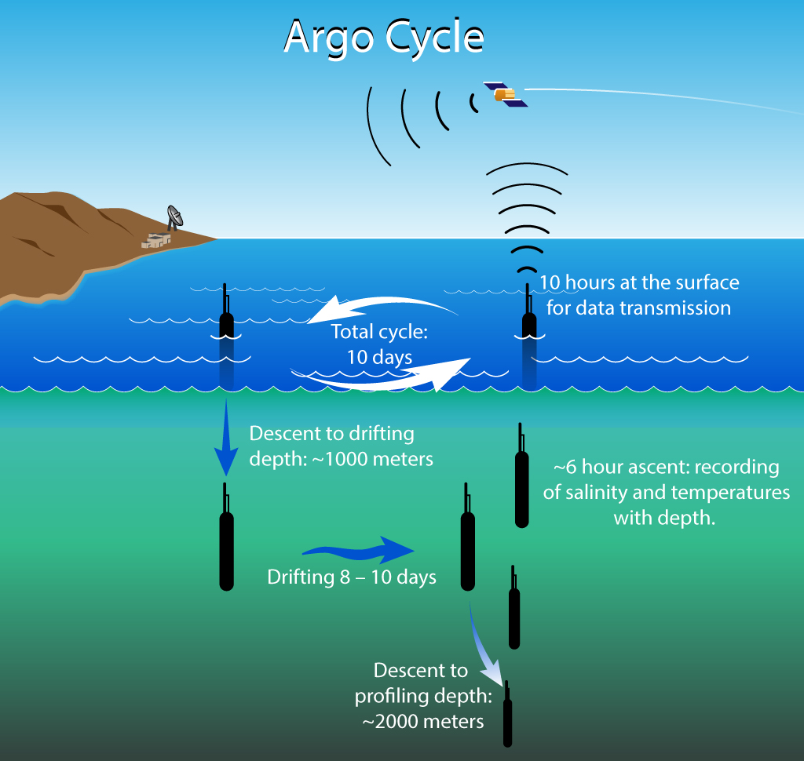
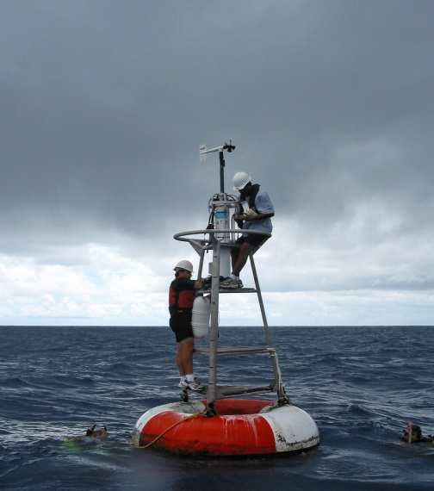
Oceans observations (2)

Slide 7
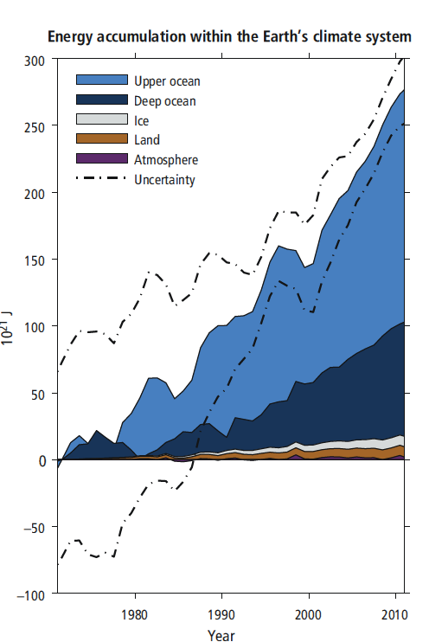
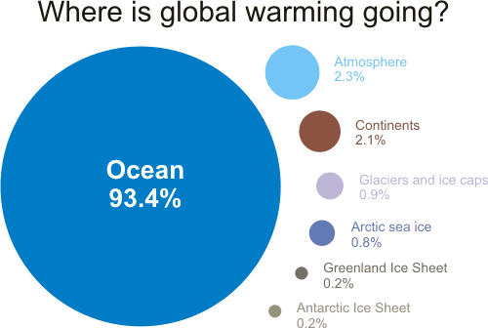
Global ocean heat content 1955-2015
Oceans absorb about 93% of extra heat
Atmosphere
2.3%
Continents
2.1%
Glaciers and ice caps
0.9%
Arctic sea ice
0.8%
Greenland ice sheet
0.2%
Antarctic ice sheet
0.2%

Slide 8
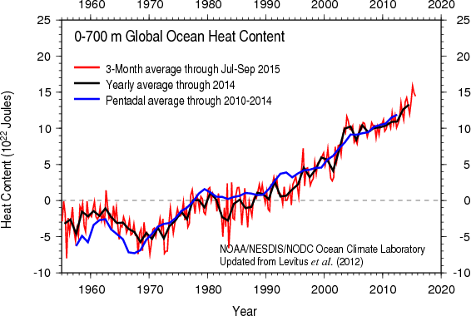
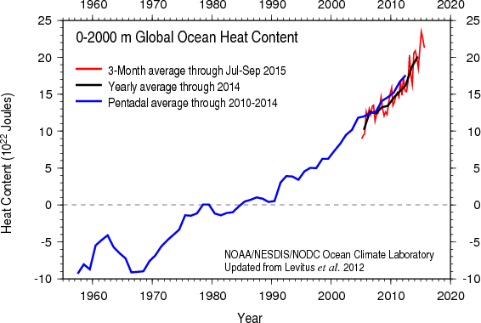
Global ocean heat content 1955-2015
0-2000 m global ocean heat content
0-700 m global ocean heat content
No climate hiatus – No Climate pause !

Slide 9
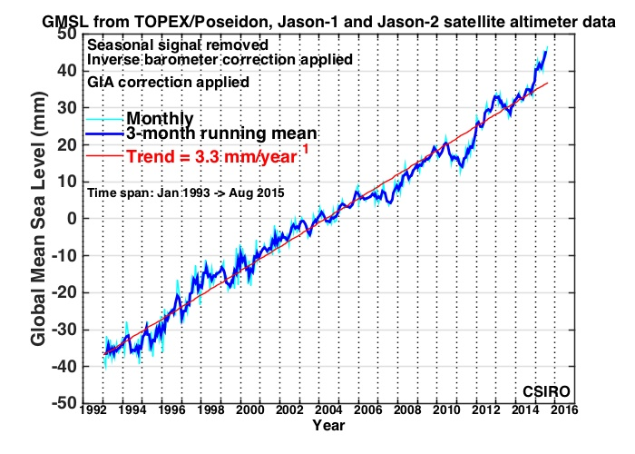
Sea level rise (1)
1901-1990: 1.9 mm/yr
1990-2010: 3.0 mm/yr
1992-2016: 3.3 mm/yr
Causes:
  thermal expansion
  Melting of land glaciers
  Others
Impacts:
  Coastal erosion
  Intrusion of salted water
  Impact of storm surges and tsunamis
  …

Slide 10
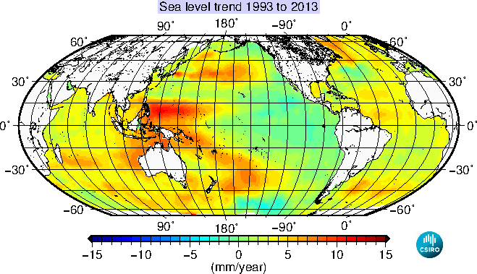
Sea level rise (2)
Trend 1993−2013

Slide 11
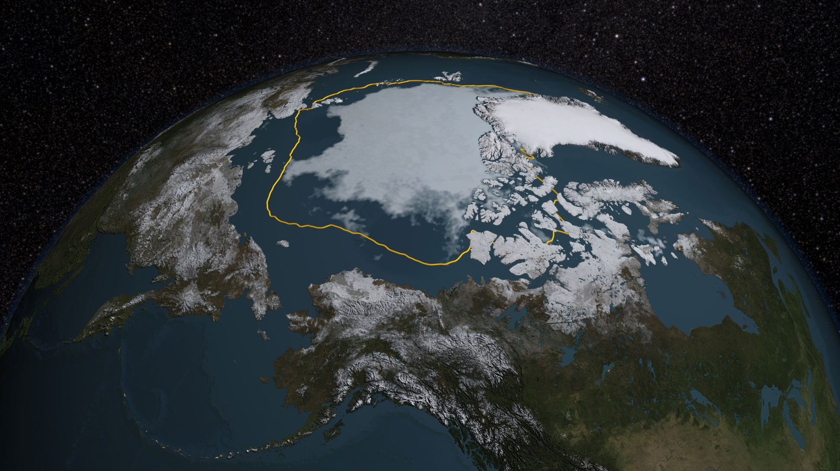
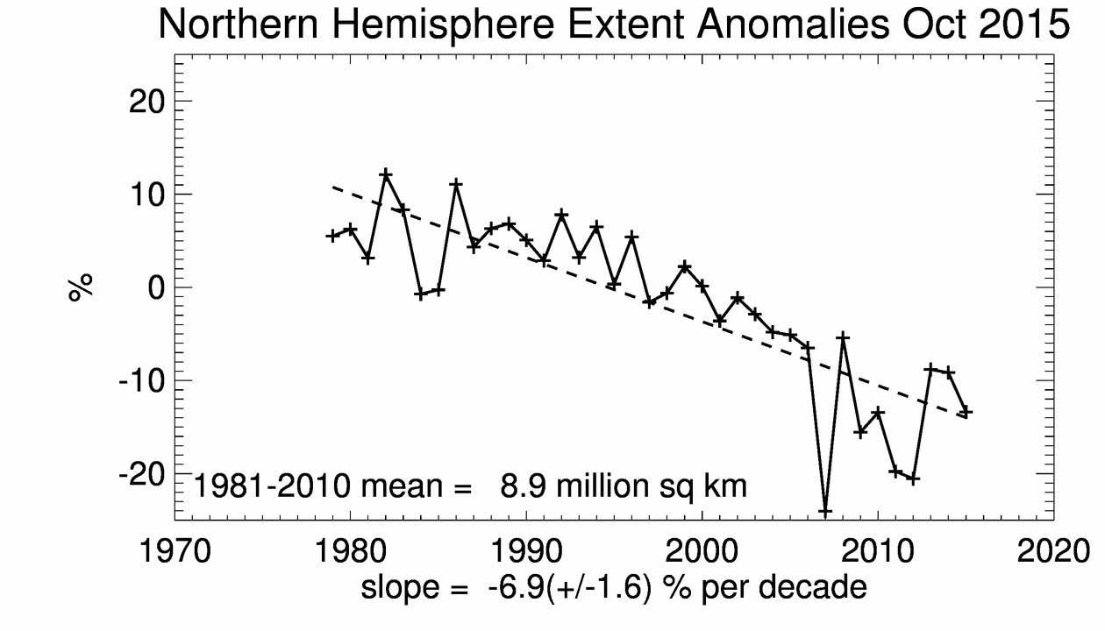
Arctic sea ice
Trend 1979−2015
-13.4% per decade
Yellow line : mean extension 1981-2010
Arctic ice extent (Sept 2015)

Slide 12
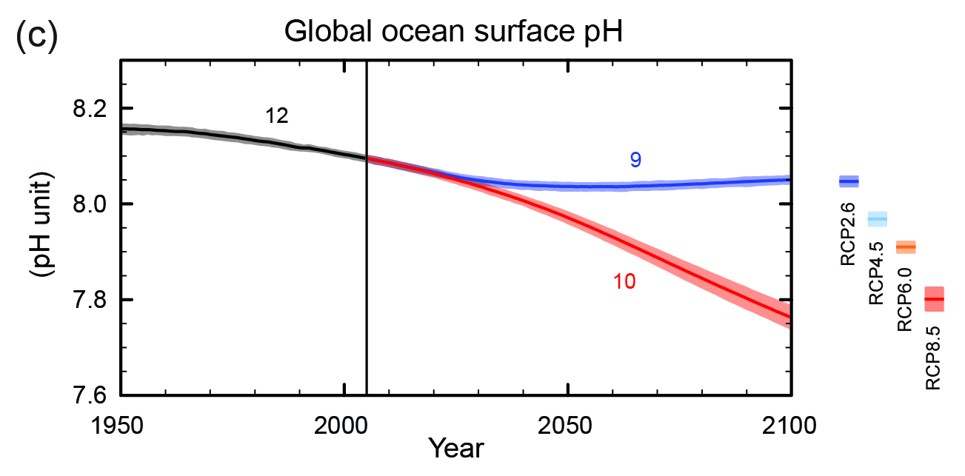
Oceans acidification and CO₂ absorption
Oceans have absorbed about 25% of all anthropogenic CO₂
Acidification: about 26% since pre-industrial time
  Rate unprecedented in last 300 million years
  Acidification will continue for centuries, even with zéro CO₂ emissions
Acidification reduces capacity of oceans to absorb CO₂
pH drop of 0.1 unit since pre-industrial times

Slide 13
From knowledge to action
Getting the information across in an authoritative, but understandable way
Strengthen cross-disciplinary cooperation
Better integration of Oceans dimension in various international agreements (Agenda 2030, Sendai framework, COP21 agreement, …)
Revisit governance and coordination mechanisms (e.g UN-Ocean)
We now have the knowledge
There is urgency to act

Slide 14
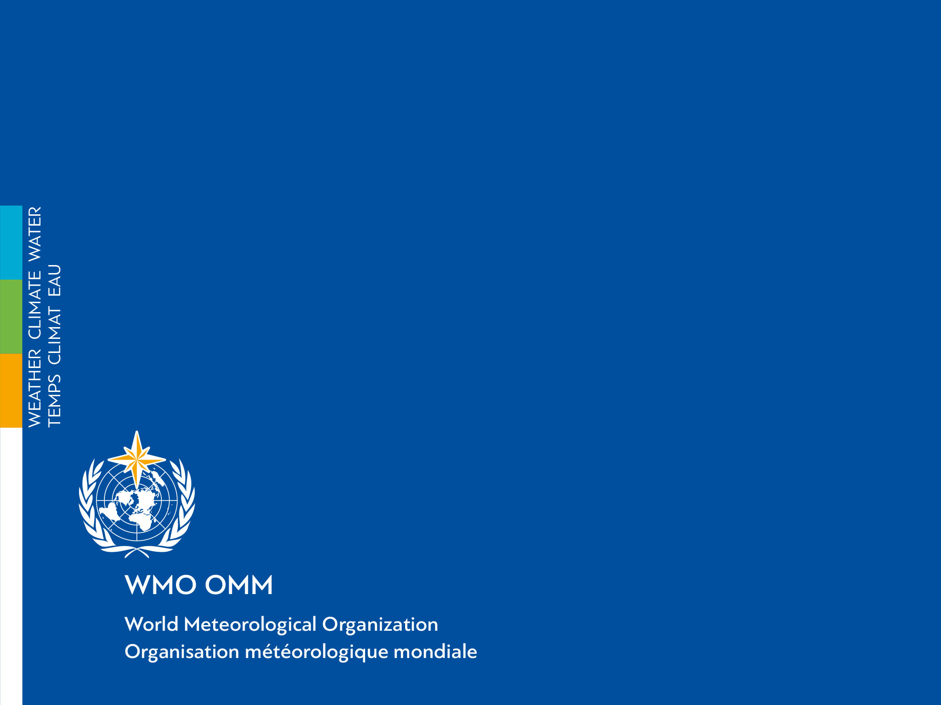
谢谢
شكرا
Gracias
Merci
Thank you
спасибо

