Slide 1
Contribution to sustainable forest management SFM in Switzerland Christian Küchli, Federal Office for the Environment, Bern
Division
GEN, Geneva, 6 June, 2011

Slide 2
Forêts de Genève: just „Teppes“

Slide 3
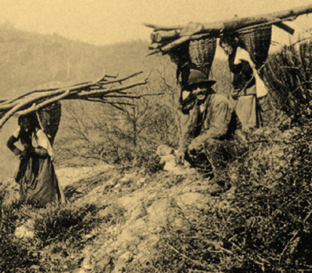
Fuel wood, tanning bark

Slide 4
Jardin Anglais and Port de la Scie, 1865

Slide 5
6000 logs in river Sarine, around 1880

Slide 6
Desaters in the hills…

Slide 7
…floods downstream in the cities

Slide 8
Age of coal-based energy

Slide 9
Coal cheaper than fuel wood

Slide 10
Federal forest law of 1876: far reaching legal provisions
2 examples:
Forest area could no longer be reduced in size
The Swiss confederation provided contributions to the salaries of the cantonal foresters as well as to reforestations.

Slide 11
Economic growth needs timber

Slide 12
Time and effort paid for from revenue of 1m³ of timber
1992
1984
1960
1940
2 h 40 min
4 h 40 min
24 h 10 min
30 h 20 min

Slide 13
Value of different forest services
value contribution of the
Confederation, Cantons
millions CHF/a millions CHF/a
Timber production 450 28
Carbon sink 15 ---
Leisure 1600 ---
Protective function 4000 120
Drinking water 80 ---
Biodiversity 2800 40
Total millions CHF/a ca. 9000 188
(0.5 Mio. t CO2 à 30.-)

Slide 14
